Slide 1

Brazil (Federative Republic of)
DIFFRACTION PHENOMENA STUDY – UHF BAND
QUESTION ITU-R 202-3/3
Document 3J/87-E
27 August 2014

Slide 2
Sumary
Introduction
Description of tests
Analysis of diffraction
Network link report
Conclusion

Slide 3
Introduction
Propagation prediction, based on Recommendations ITU‑R P.526 – Propagation by diffraction.
Two diffraction models were considered:
  Cascade Knife Edge (Recommendation ITU-R P.526-11); and
  Delta-Bullington (Recommendation ITU-R P.526-12).

Slide 4
Description of tests
Source:
  Television broadcast station
  Frequency: 563.143MHz – Modulation: 64QAM
  Coordinates: latitude 22°57'6.15" South & longitude 43°14' 14.10" West.
Some routes were chosen to capture the transmitted waves, surrounding natural obstacles (mountains), in order to evaluate the diffraction mechanism.
In each test point, photos were taken in the direction of the transmitter in order to identify the main obstacles in the line of sight from the receiver to the transmitter.

Slide 5
Analysis of diffraction
Explored geographical area [Guanabara Bay] with 11 of the 96 measurement points
Figure 1

Slide 6
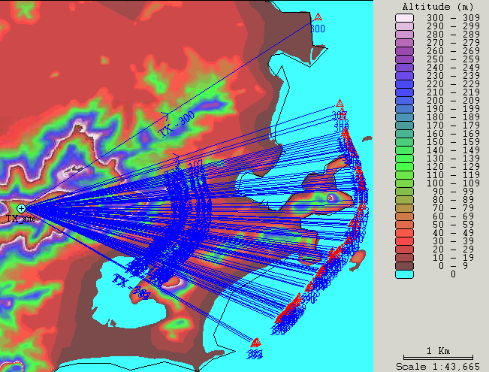
Analysis of diffraction (Cont.)
Geographical distribution of the 96 points and terrain altitude
Figure 2

Slide 7
Analysis of diffraction (Cont.)
Graphical comparison between measured and simulated signal levels
Figure 3

Slide 8
Analysis of diffraction (Cont.)
Measured and simulated signal levels on points with severe diffraction
Table 1

Slide 9
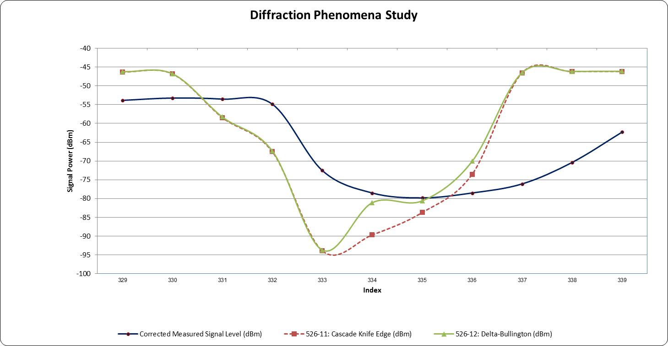
Analysis of diffraction (Cont.)
Comparison between measured and predicted signal levels in points of severe diffraction
Figure 4

Slide 10
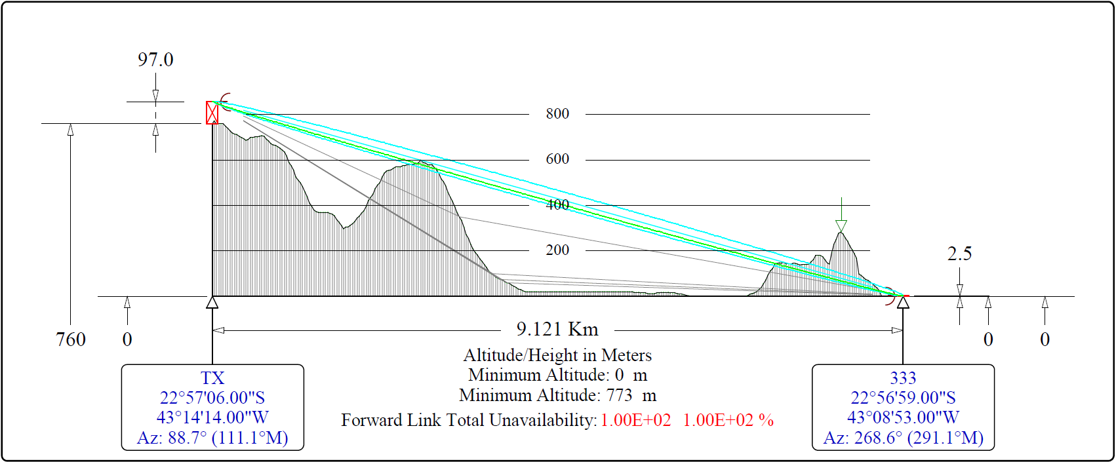
Analysis of diffraction (Cont.)
Terrain profile for measurement 333
Figure 5

Slide 11
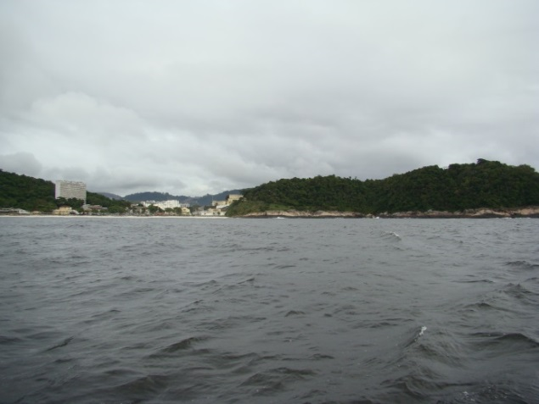
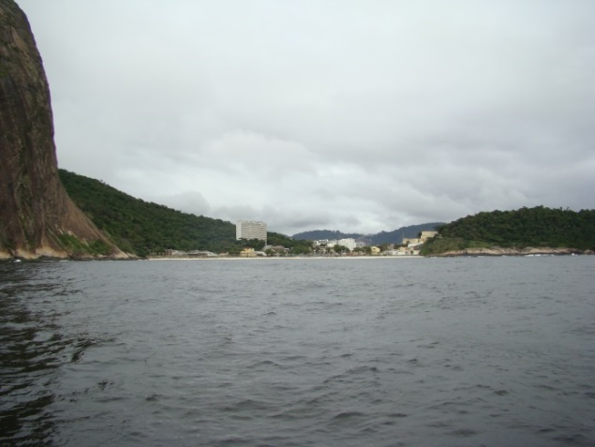
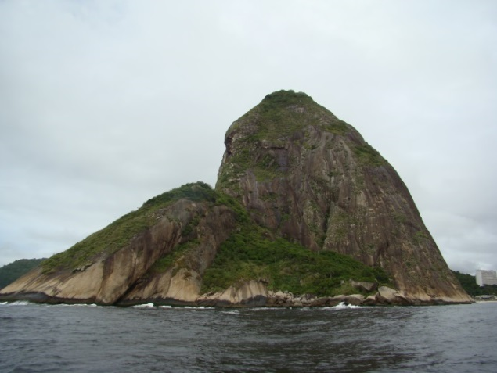
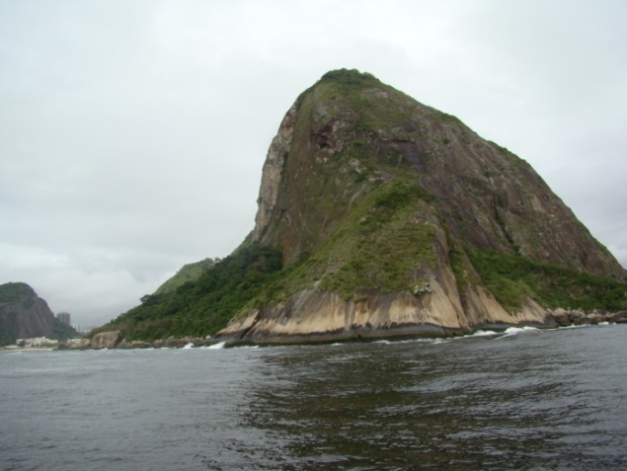
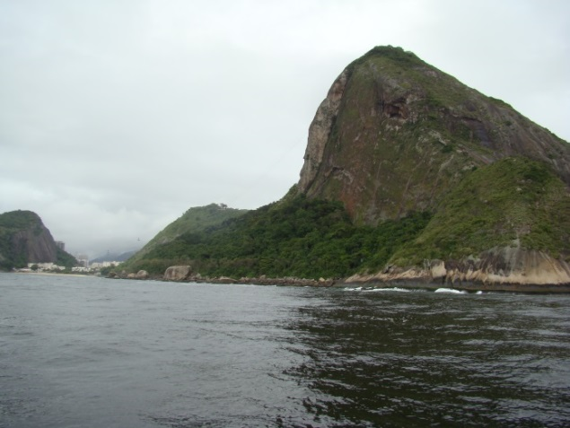
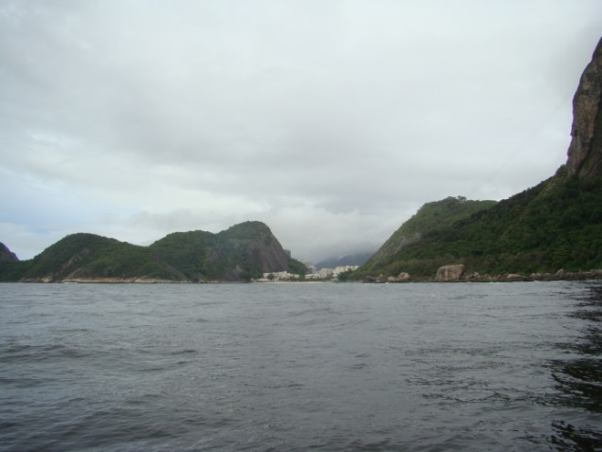
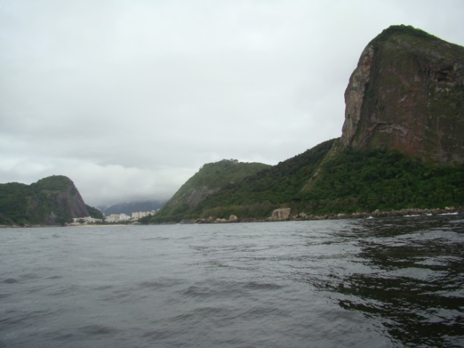
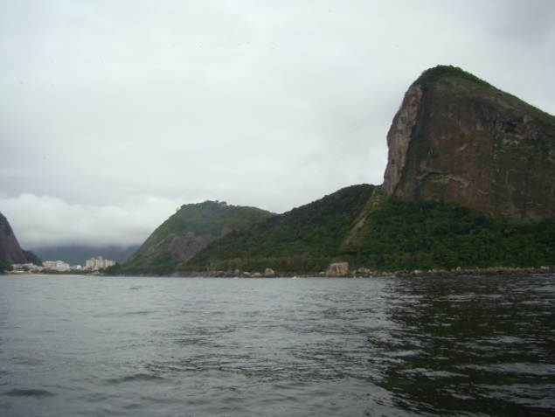
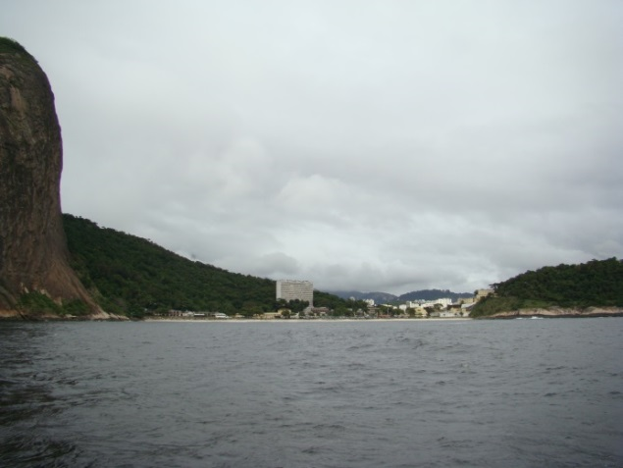
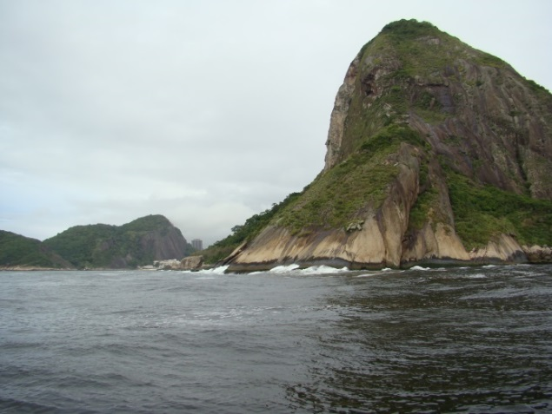
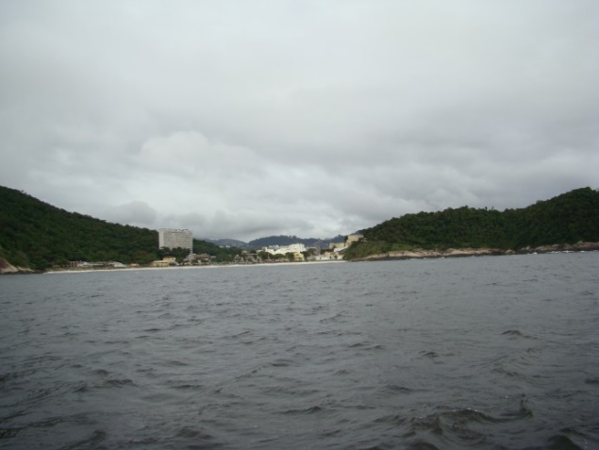
Analysis of diffraction (Cont.)
Landscape from measurements

Slide 12
Network link report
In order to clarify the calculations, attachments were provided with link reports using the Cascade Knife Edge and Delta-Bullington methods for comparison of results.
Annex 1 - Link index 313 - Cascade Knife Edge model - Only free space loss
Annex 2 - Link index 313 - Delta-Bullingtonmodel - Only free space loss
Annex 3 - Link the index 333 - Cascade Knife Edge model - Diffraction loss 46.53 dB
Annex 4 - Link the index 333 - Delta-Bullingtonmodel - Diffraction loss 46.40 dB
Annex 5 - Link the index 335 - Cascade Knife Edge model - Diffraction loss 37.50 dB
Annex 6 - Link the index 333 - Delta-Bullingtonmodel - Diffraction loss 34.42 dB

Slide 13
Conclusion
The intention of this study is to provide detailed data for testing, analysis and improvement of Recommendation ITU-R P.526 Propagation by Diffraction.
The available data provided useful information for assessment of the obstacles, making it possible to investigate the effects of their shapes on propagation mechanism.

Slide 14
Conclusion (Cont.)
After the analysis of the results, the similarity between the diffraction models Cascade Knife Edge and Delta-Bullington seems evident, as seen in Figures 3 and 4.
When comparing the simulated results with measured ones, it is possible to conclude that the Cascade Knife Edge and Delta-Bullington models are rather pessimist, i.e., they consider greater signal attenuation due to diffraction losses.

Slide 15
Conclusion (Cont.)
Apparently, the result of the pessimist prediction of propagation by diffraction of recommendation 526 is due to the fact that the real obstacles are not really rectangular barriers, but obstacles with curved borders that allow lateral leakage of energy.
It is recommended to consider this contribution information to improve the Recommendation ITU‑R P.526 Propagation by Diffraction.

